Slide 1
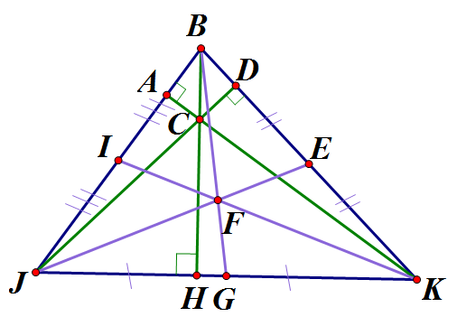
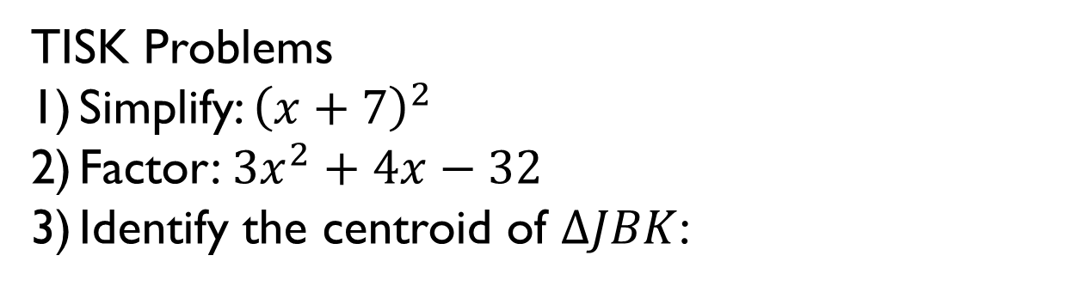
Wednesday, November 14, 2012
Agenda:
TISK, No MM
Lesson 6-1: Prove statements about parallelograms.
Homework: Ch 6 Packet 1 #1-5
TISK Problems
Simplify: ${\left(x+7\right)}^{2}$
Factor: ${3x}^{2}+4x−32$
Identify the centroid of $ΔJBK$:

Slide 2
§6.1 Parallelograms
Definition
A quadrilateral is a parallelogram if and only if its opposite sides are parallel.
C
D
If
then
ABCD is a parallelogram.
A
B

Slide 3





Parallel? Great news!
We have lots of things we know about parallel lines!
Alternate Interior Angles Theorem
Alternate Exterior Angles Theorem
Consecutive Interior Angles Theorem
Corresponding Angles Postulate
So let’s look at a parallelogram…
What are some of the things we know about it?
$∠1 and ∠2$are supp. (CIA Th.)
3
2
The same is true for $∠1 and ∠4$ (using the left and right sides and CIA Th.)!
Then $∠3 and ∠4$ are also supp,.
$∴$ $∠2≅∠4$ ($≅$ Supp. Th.).
4
1
$∴$ $∠1≅∠3$ ($≅$ Supp. Th.).

Slide 4

Theorems
If a quadrilateral is a parallelogram, then its consecutive angles are supplementary.
C
D
$$∠A and ∠B are supplementary$$
$$∠A and ∠C are supplementary$$
$$∠B and ∠D are supplementary$$
$$∠C and ∠D are supplementary$$
If
then
A
B

Slide 5
Theorems
If a quadrilateral is a parallelogram, then its opposite angles are congruent.
C
C
D
If
D
then
A
B
A
B

Slide 6

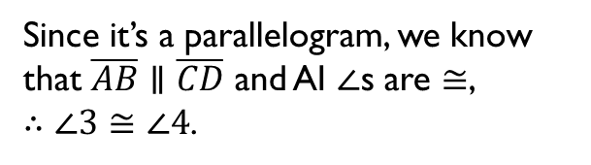


Let’s look at what happens if we draw in a diagonal…
A
B
Hey! Two triangles!
So all our stuff about triangles works here, too!
1
3
D
4
2
C
Since it’s a parallelogram, we know that $\overline{AB}∥\overline{CD}$ and AI $∠$s are $≅$, $∴∠3≅∠4$.
Using the same reasoning, we know that $\overline{AD}∥\overline{BC}$ $∴∠1≅∠2$.
Then, by ASA, $ΔADC≅ΔCBA$.
$∴$, because CPCTC, $\overline{AB}≅\overline{CD}$ and $\overline{AD}≅\overline{BC}$.

Slide 7
Theorems
If a quadrilateral is a parallelogram, then its opposite sides are congruent.
C
C
D
D
If
then
A
B
A
B

Slide 8
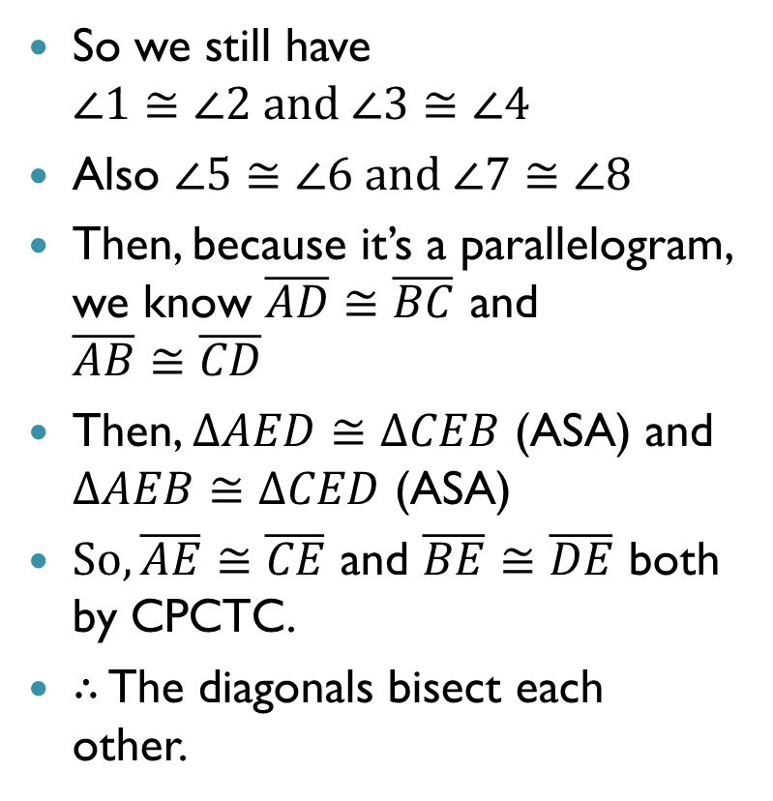
What if we draw in BOTH diagonals?
A
B
So we still have $∠1≅∠2 and ∠3≅∠4$
Also $∠5≅∠6 and ∠7≅∠8$
Then, because it’s a parallelogram, we know $\overline{AD}≅\overline{BC}$ and $\overline{AB}≅\overline{CD}$
Then, $ΔAED≅ΔCEB$ (ASA) and $ΔAEB≅ΔCED$ (ASA)
$So, \overline{AE}≅\overline{CE}$ and $\overline{BE}≅\overline{DE}$ both by CPCTC.
$∴$ The diagonals bisect each other.
3
5
1
7
E
8
6
4
2
D
C

Slide 9
Theorems
If a quadrilateral is a parallelogram, then its diagonals bisect each other.
C
D
C
D
If
then
A
B
A
B

Slide 10
Example 1. STUV is a parallelogram. Find the unknown measures.
S
T
12
W
14
V
U
a) TU
TU = SV
If a quad is a $∥$ogram, $⇒$ opp. sides are $≅$
TU = 12
Substitution.
b) WT
WT = WV
If a quad is a $∥$ogram, $⇒$ diag’s bisect each other.
WT= 14
Substitution.

Slide 11
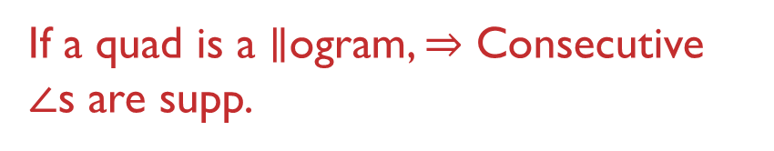


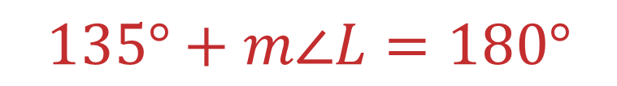

Example 2. JKLM is a parallelogram. Find $m∠L$.
$$m∠M+m∠L=180°$$
J
K
If a quad is a $∥$ogram, $⇒$ Consecutive $∠$s are supp.
$$135°+m∠L=180°$$
Substitution.
135º
$$m∠L=45°$$
M
L
Subtraction.

Slide 12







Example 3. ABCD is a parallelogram. Find the value of x.
$$m∠A=m∠C$$
C
D
$$(9x+2)°$$
If a quad is a $∥$ogram, $⇒$ opp. $∠$s are $≅$
$$(12x−34)°$$
$$12x−34=9x+2$$
B
A
Substitution.
$$3x=36$$
$$x=12$$

Slide 13
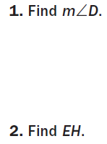
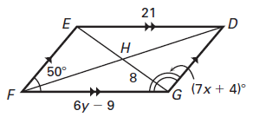


Check Points. DEFG is a parallelogram. Find the indicated measures and explain your reasoning.
$m∠$EDG
50$°$

